Slide 1






Superstore Analysis
Yara
Mahmoud
Ahmed Osama
Mostafa Yacoub

Slide 2
Table Of Contents
1
Introduction
4
Insights & Findings
2
Business Question
5
Visualization
3
Analysis Steps
6 Recommendations

Slide 3

Introduction
This analysis focuses on exploring key performance metrics for customer behavior and sales trends over time. By leveraging data analytics techniques, the analysis aims to provide insights into customer retention, growth, and operational efficiency in order fulfillment.

Slide 4

Project Objective
The goal of this project is to analyze To provide insights into sales trends, product performance, and customer behavior to drive data-driven decision-making for executives and decision-makers

Slide 5
Business Questions
How diverse is our product offering across different categories
How many unique customers have we served so far
What is the total number of products we currently offer
What is the total number of transactions processed over time?
What is the average time taken to ship an order? Are there any delays or efficiency issues in our fulfillment of process?
How is our customer base growing or shrinking year over year?
How much have our sales grown (or declined) compared to previous years?
Which regions contribute the most to our order volume?
Which states have the most customers?
How has the number of customers in different segments (Consumer, Corporate, Home Office) grown from 2015 to 2018?
Who are our top 5 customers based on their total purchase value?

Slide 6
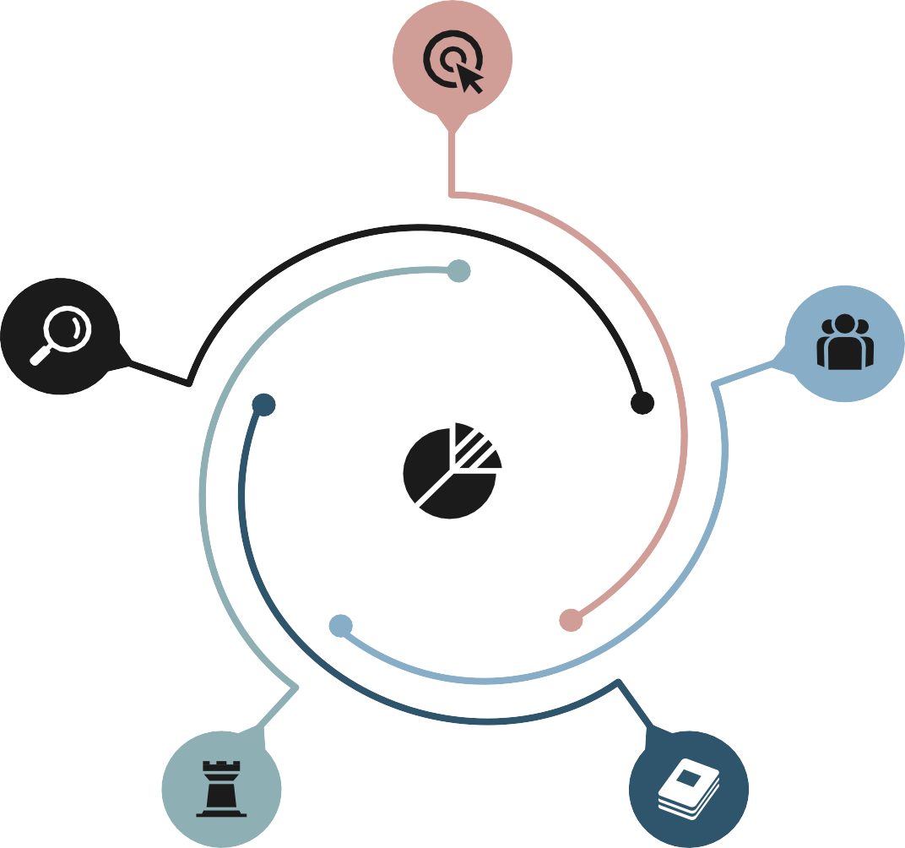
Analysis Steps
Data Collection
Data Analysis
Data Cleaning
Exploratory Data Analysis (EDA)
Data Model

Slide 7

Data Cleaning
Data : The columns Order Date and Ship Date were converted to datetime format.
The missing values in the Postal Code column were filled in by grouping on City and using the mode..
Common Issues Detected:
Missing Data
Errors
Duplicates
Data Type Mismatches: Certain columns may have incorrect data types (e.g., times stored as text).

Slide 8
Data Modelling
We divided the data into:
Fact table: Contains detailed sales transaction data, including Row ID, Order ID, Order Date , Ship Date, Customer ID, Product ID, Region ID, Ship ID, Sales.
• Dim Products table: Contains product-related columns such as Product ID, Product
Name, Category, and Sub-Category.
Dim Date : Contains date-related columns such as Date, Day, Month, Quarter, and Year.
Dim Regions table: Contains region-related columns such as Region ID, Region, Country, State, City, and Postal Code.
Dim Ship table: Contains shipping-related columns such as Ship ID and Ship Mode.
Dim Customers table: Contains customer-related columns such as Customer ID, Customer Name, and Segment

Slide 9
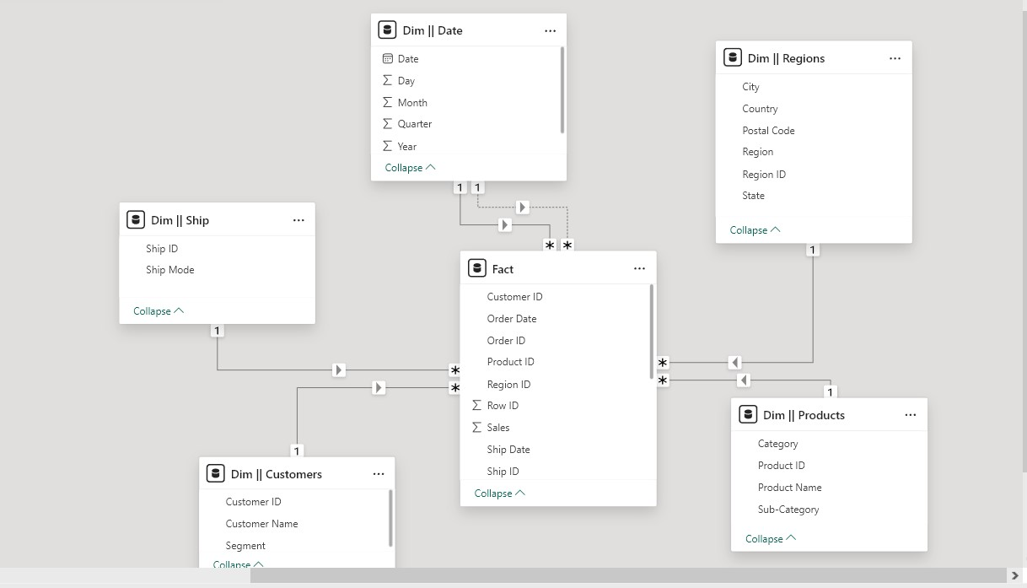
Data Modelling

Slide 10
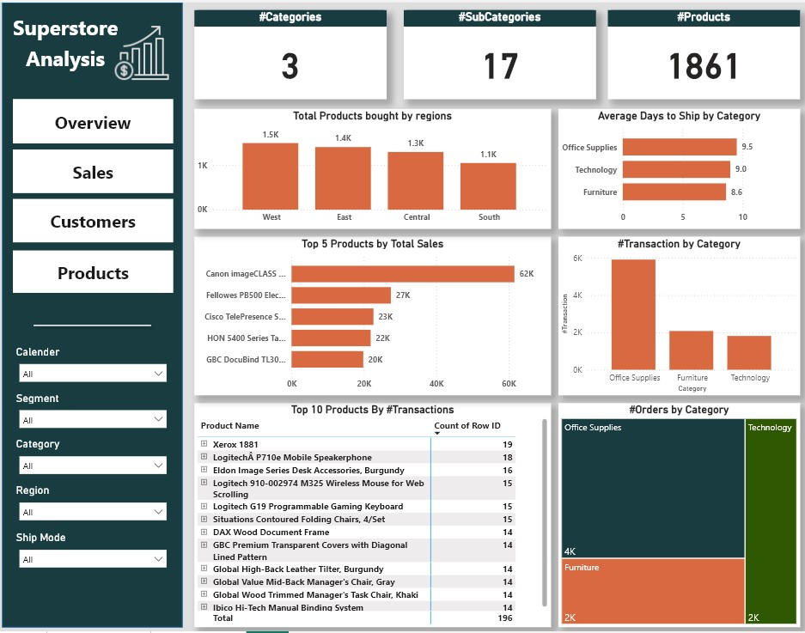
Overview Insights

Slide 11
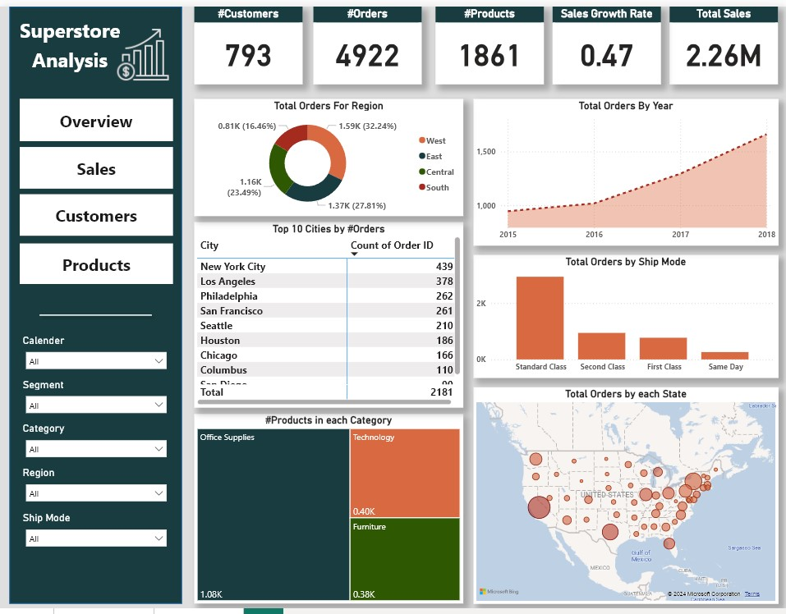
Overview Insights

Slide 12
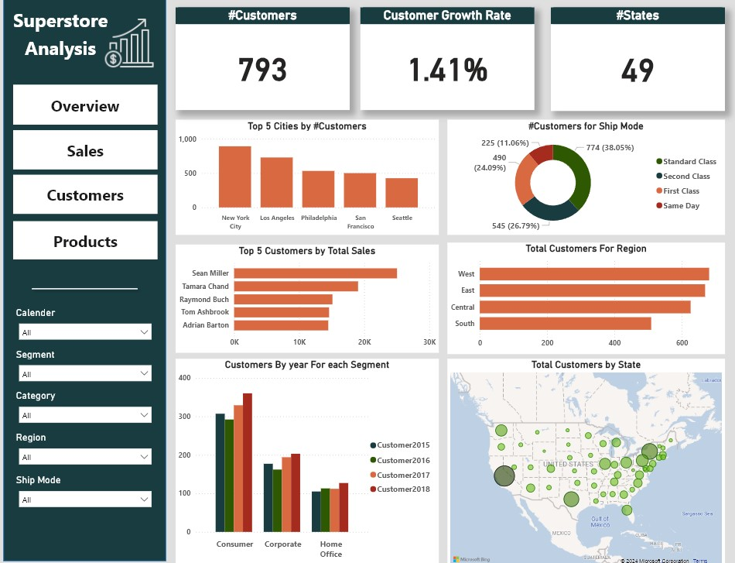
Overview Insights

Slide 13
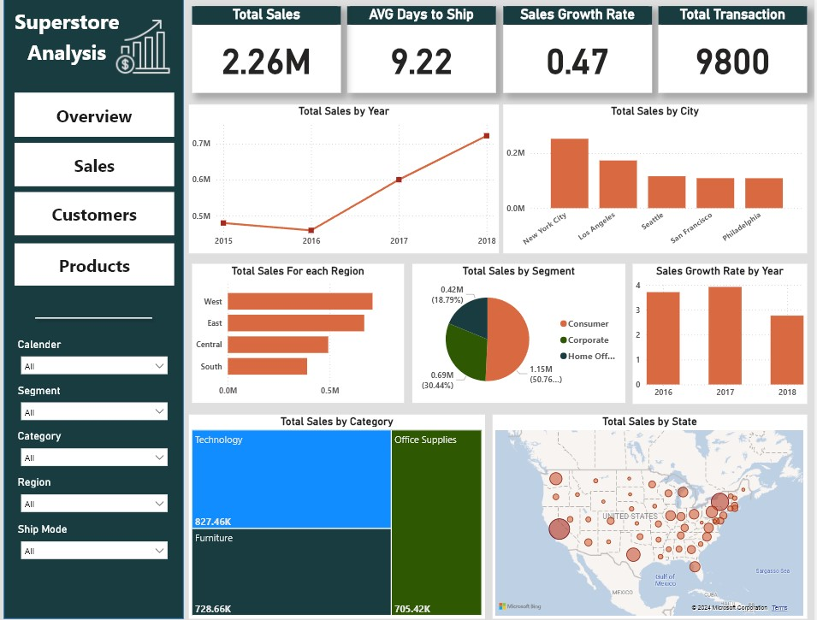
Overview Insights

Slide 14
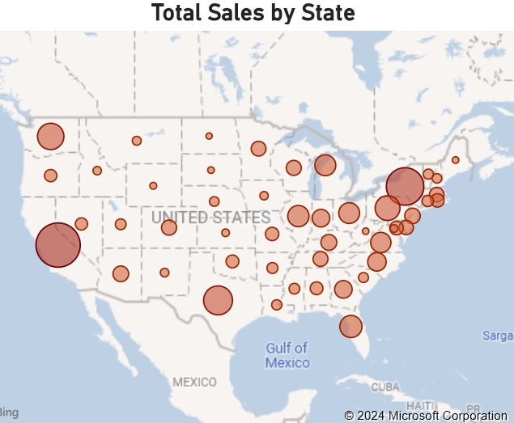
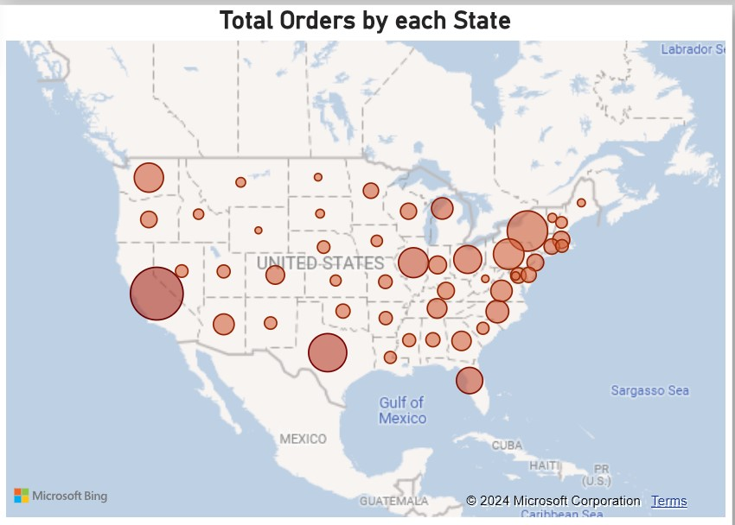
Map Insights

Slide 15
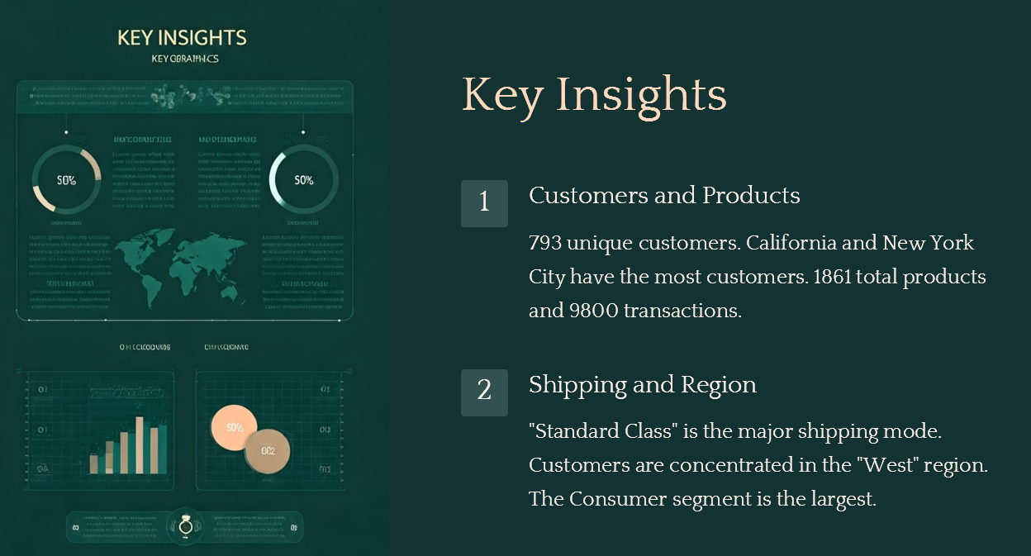

Slide 16
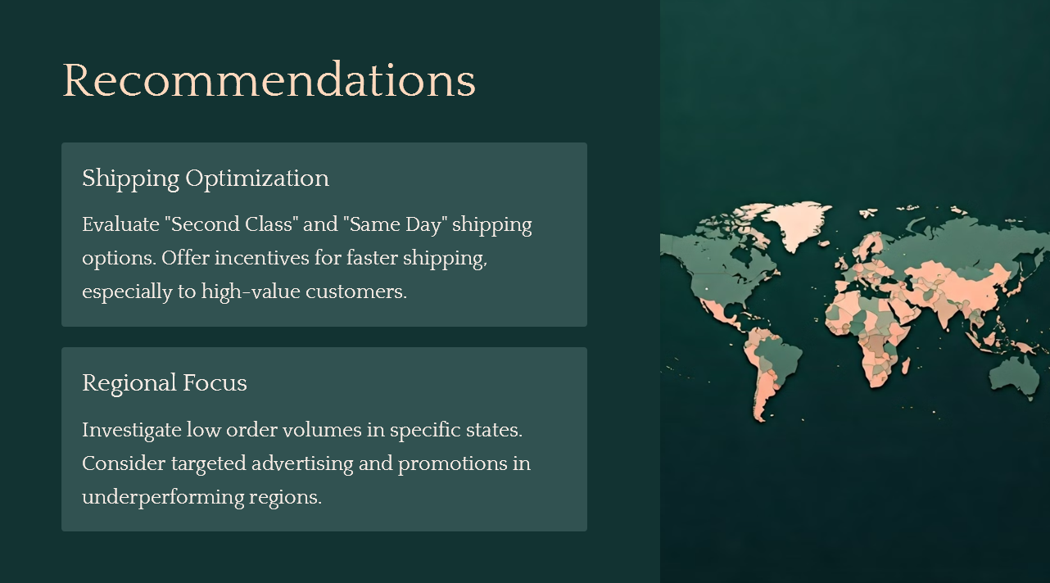
Shipping Recommendations

Slide 17
Thank You

